Slide 1



Measurement of jet spectra in Pb-Pb collisions at √s_{NN}=2.76 TeV with ALICE
Salvatore Aiola,
on behalf of the ALICE collaboration
INFN Catania and LBNL

Slide 2
Outline
Introduction
Analysis overview
Jet reconstruction
Background estimation
Unfolding
Jet spectra
Conclusions & Outlook

Slide 3
Jets in heavy-ion collisions
Jet: collimated spray of hadrons
QCD branching of a high p_{T} parton
Subsequent hadronization of fragments
Experimentally grouped according to given procedure, jet algorithm
Jets can be used to probe the hot QCD medium
Observable properties modified by the medium
p_{T} distribution
…and many more

Slide 4
Jets in heavy-ion collisions
Jet: collimated spray of hadrons
QCD branching of a high p_{T} parton
Subsequent hadronization of fragments
Experimentally grouped according to given procedure, jet algorithm
Jets can be used to probe the hot QCD medium
Observable properties modified by the medium
p_{T} distribution
…and many more
Experimentally challenging
Huge background given by the underlying event (UE)
Average background
Combinatorial jets
p_{T} smearing due to background fluctuations
Jet-by-jet and
event-by-event correction

Slide 5
Jets in heavy-ion collisions
Jet: collimated spray of hadrons
QCD branching of a high p_{T} parton
Subsequent hadronization of fragments
Experimentally grouped according to given procedure, jet algorithm
Jets can be used to probe the hot QCD medium
Observable properties modified by the medium
p_{T} distribution
…and many more
Experimentally challenging
Huge background given by the underlying event (UE)
Average background
Combinatorial jets
p_{T} smearing due to background fluctuations
Efficiently removed by a leading hadron p_{T} requirement

Slide 6
Jets in heavy-ion collisions
Jet: collimated spray of hadrons
QCD branching of a high p_{T} parton
Subsequent hadronization of fragments
Experimentally grouped according to given procedure, jet algorithm
Jets can be used to probe the hot QCD medium
Observable properties modified by the medium
p_{T} distribution
…and many more
Experimentally challenging
Huge background given by the underlying event (UE)
Average background
Combinatorial jets
p_{T} smearing due to background fluctuations
Statistical correction based on δp_{T} distributions

Slide 7
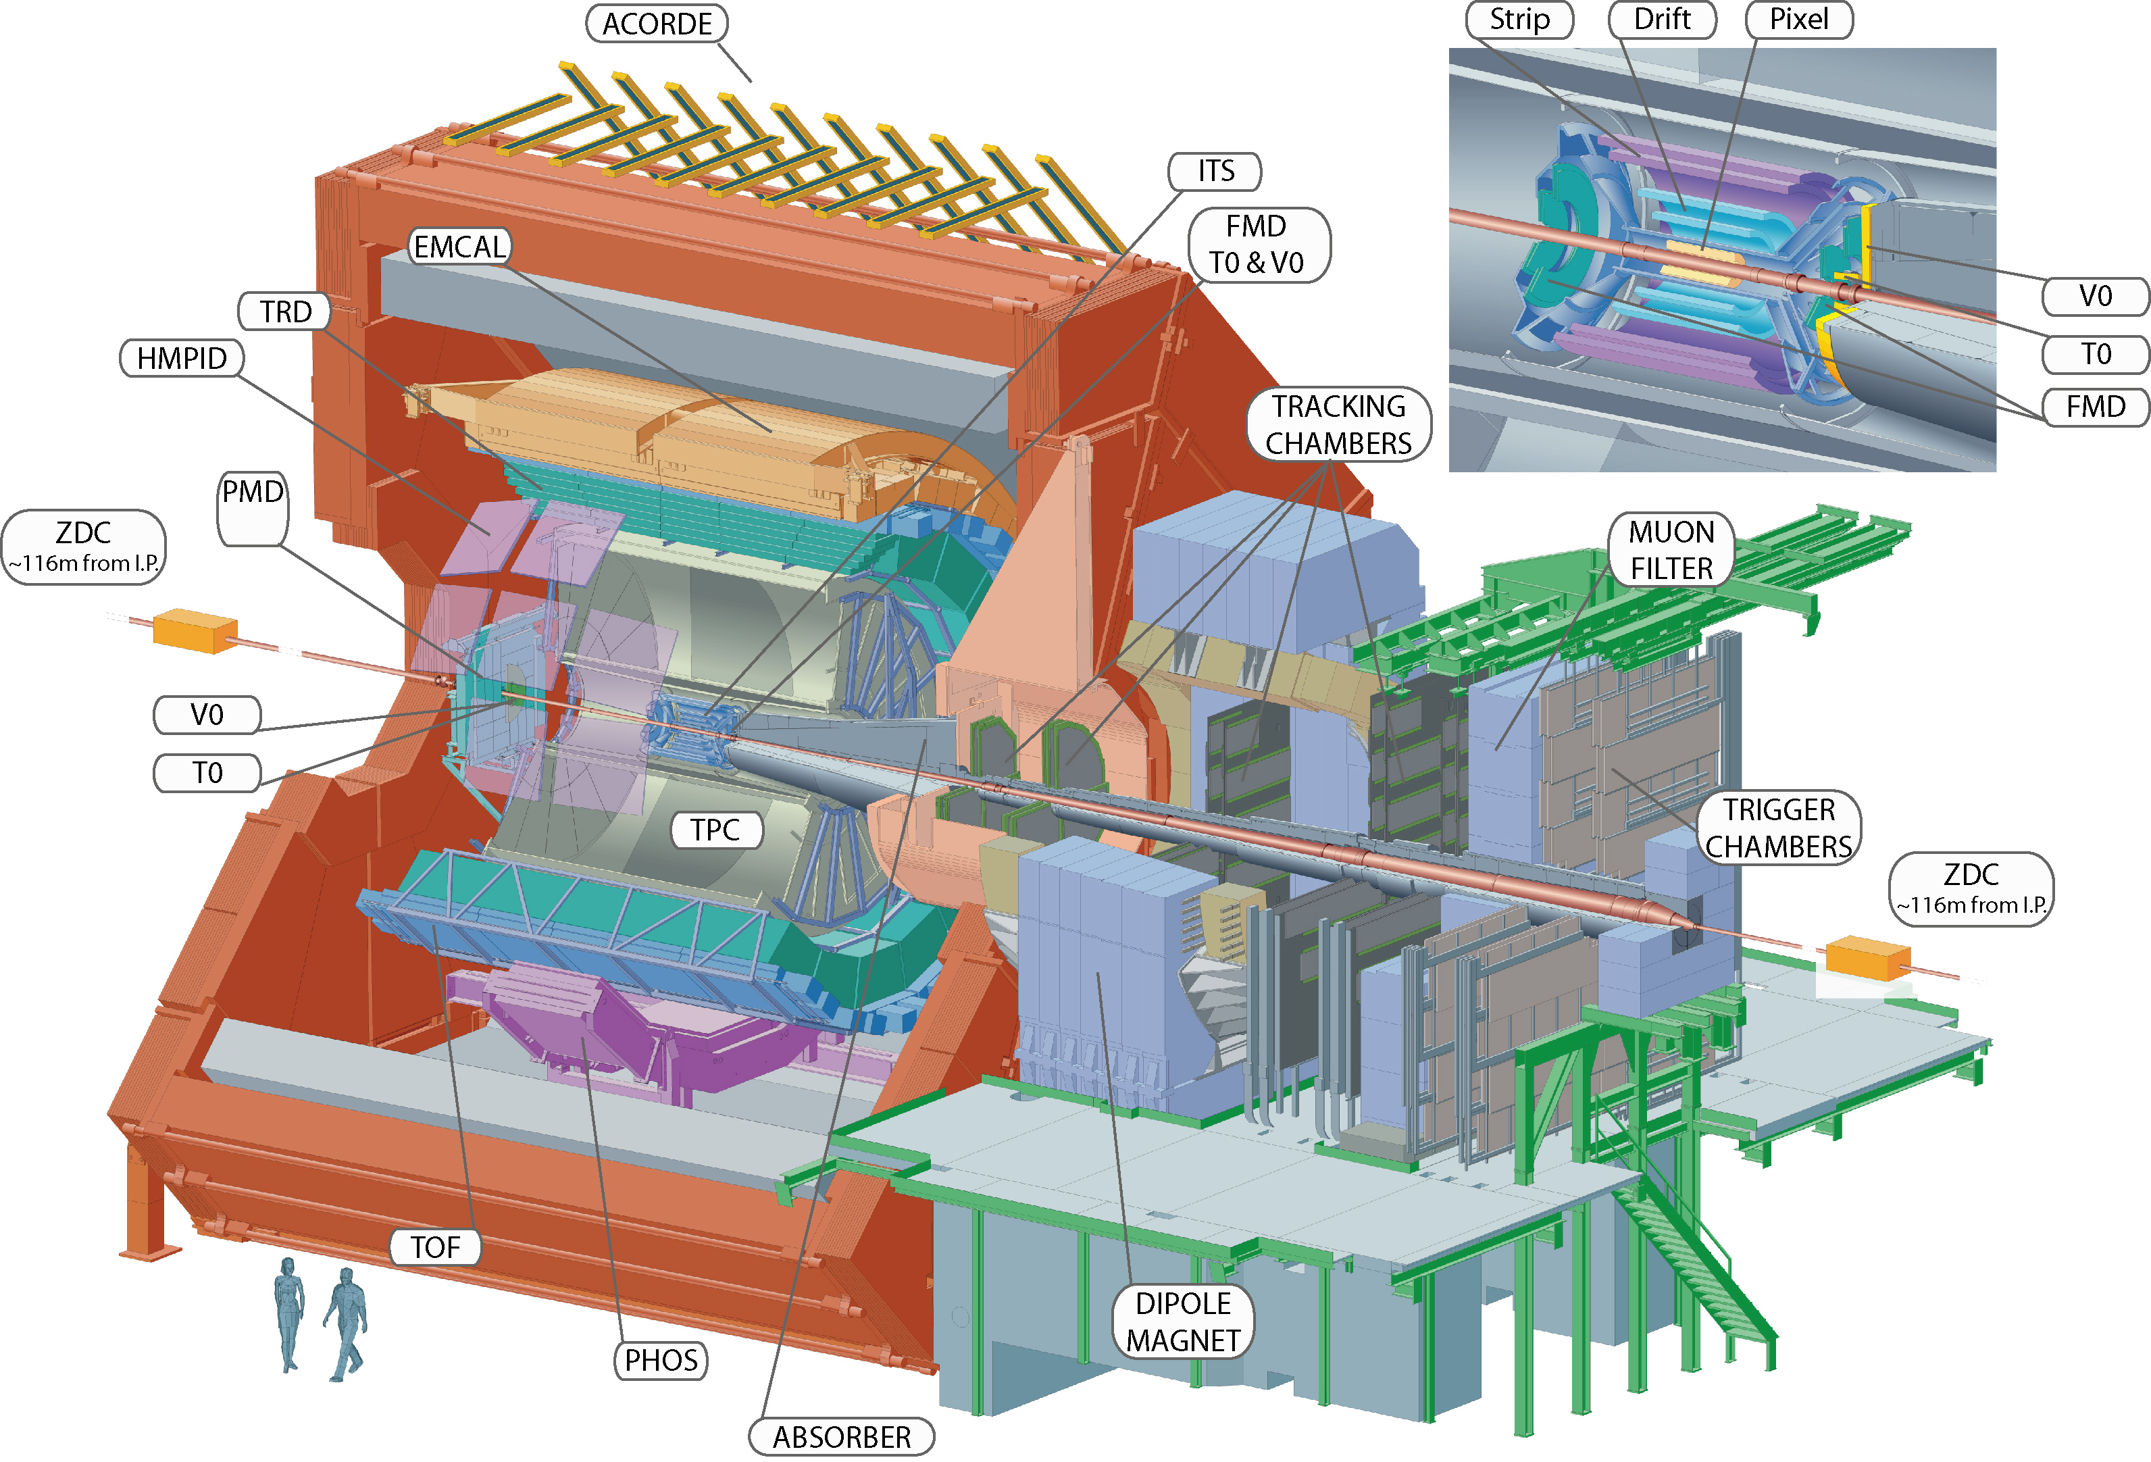
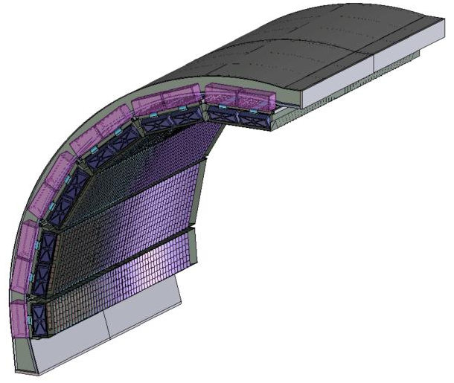
Analysis overview
Tracking:|η| < 0.9, 0° < ϕ < 360°
TPC: gas detector
ITS: silicon detector
Charged tracks
Average background subtraction
Corrected EMCal clusters
Charged tracks
Hadroniccorrection
EMCal clusters
Jet finder
Anti-k_{T}
Final jet spectrum
EMCal
Pb-scintillator sampling calorimeter
|η| < 0.7, 80° < ϕ < 180°
Unfolding
Inverse matrix calculation through numerical methods
Raw jet spectrum
f^{raw}(p_{T}) = RM_{bkg} × RM_{det} × f^{true}(p_{T})

Slide 8
Jet reconstruction
Inputs to the jet finder
Assumed to be massless
Charged tracks with p_{T} > 150 MeV/c
EMCal clusters with E_{T} > 300 MeV/c after charged particle correction
Jet reconstructed using FastJet* package
Infrared- and Collinear-Safe algorithms
Good for comparison with theory
Radii R = 0.2, 0.3
Area cut A > 0.6 * πR² removes extremes
Fiducial cut selects jets fully contained in the EMCal acceptance
Sequential recombination
p = 1
k_{T} algorithm
Clustering starts from the low p_{T} particles
Used for ρ calculation
p = -1
Anti-k_{T} algorithm
Clustering starts from the highest p_{T} particle, regular cone-like jet shapes
Used for signal jets
*M. Cacciari, G.P. Salam and G. Soyez
Eur.Phys.J. C72 (2012) 1896 [arXiv:1111.6097]

Slide 9
1. Average background
Charged+neutral momentum density / charged only momentum density
Calculated on an event-by-event basis
The median of the density of k_{T} charged jets gives ρ_{ch}
A parametrization of the scale s_{EMC} factor as a function of centrality is used
to obtain ρ_{ch+ne}

Slide 10
2. Leading hadron trigger
Combinatorial jets: jet finder clusters together also soft particles from the UE
Efficiently remove the fake jets by requiring a high p_{T} constituent
Bigger effect when changing the p_{T} threshold from 0 ➔ 5 GeV/c than 5➔10 GeV/c
Bias still effective up to 100 GeV/c
R=0.2
R=0.3
5 GeV/c is our default choice for R=0.2 jet spectra

Slide 11
3. Background fluctuations
Region-by-region background fluctuations are estimated through random cones (solid symbols) and single particle embedding (open symbols)
Fluctuations limit jet energy resolution
Smearing of the p_{T} raw jet spectrum
Random cones
Throw a random direction in the (η,φ) plane
Sum up the momenta of all particles in the cone of radius R
Calculate
Single particle embedding
Embed a high p_{T} particle
Run the Anti-k_{T} jet finder
Pick up the jet which contain the embedded particle and calculate

Slide 12
Response matrices
Detector effects
PYTHIA+GEANT3 simulation
Assumes jet detector response is the same as in vacuum fragmentation
Shift jet energy scale ~ 20-25%
Unreconstructed neutrons and K⁰_{L}
Tracking inefficiency
Jet energy resolution ~ 18%
Jet reconstruction efficiency ~ 95% at 80 GeV/c

Slide 13
Response matrices
Background fluctuations
δp_{T} distribution (RC)
R = 0.2 ➔ σ = 4.9 GeV/c
R = 0.3 ➔ σ = 8.5 GeV/c

Slide 14
Response matrices

Slide 15
Why unfolding
Remove detector and analysis specific features from the observables to be compared with theory
Another simpler but less elegant approach: use the response matrix to include these distortions in the theoretical predictions
Advantages of unfolding
Comparison between experiments is possible
Final results are more “fundamental” and easier to read

Slide 16
Why unfolding
Remove detector and analysis specific features from the observables to be compared with theory
Another simpler but less elegant approach: use the response matrix to include these distortions in the theoretical predictions
Advantages of unfolding
Comparison between experiments is possible
Final results are more “fundamental” and easier to read
Different unfolding methods
Χ² minimization

Slide 17
Why unfolding
Remove detector and analysis specific features from the observables to be compared with theory
Another simpler but less elegant approach: use the response matrix to include these distortions in the theoretical predictions
Advantages of unfolding
Comparison between experiments is possible
Final results are more “fundamental” and easier to read
Different unfolding methods
Χ² minimization
Bayesian
Uses the Bayes’ theorem to iteratively update the estimators’ probabilities, starting from a “prior” guess
Bayes’ theorem

Slide 18
Why unfolding
Remove detector and analysis specific features from the observables to be compared with theory
Another simpler but less elegant approach: use the response matrix to include these distortions in the theoretical predictions
Advantages of unfolding
Comparison between experiments is possible
Final results are more “fundamental” and easier to read
Different unfolding methods
Χ² minimization
Bayesian
Uses the Bayes’ theorem to iteratively update the estimators’ probabilities, starting from a “prior” guess
Infinite iterations would give the best mathematical solution, but highly fluctuating, not useful for physics

Slide 19
Why unfolding
Remove detector and analysis specific features from the observables to be compared with theory
Another simpler but less elegant approach: use the response matrix to include these distortions in the theoretical predictions
Advantages of unfolding
Comparison between experiments is possible
Final results are more “fundamental” and easier to read
Different unfolding methods
Χ² minimization
Bayesian
Uses the Bayes’ theorem to iteratively update the estimators’ probabilities, starting from a “prior” guess (finite # of iterations)
Infinite iterations would give the best mathematical solution, but highly fluctuating, not useful for physics
Regularization parameter: a priori knowledge about spectrum shape
Avoids wildly fluctuating results
Introduce a bias in the result
G. D’Agostini, Nuclear Instr. Meth., 362 (1995) 487-498
G. Cowan, A Survey of Unfolding Methods in Part. Phys., Proc. Adv. Stat. Tech. in Part. Phys., Durham (2002) (link)

Slide 20
Bayesian unfolding results – R=0.2
Measured p_{T} range
Unfolded p_{T} range
Residual combinatorial jets
Iteration choice

Slide 21
Bayesian unfolding results – R=0.3
Unfolding instabilities…
p_{T,leading} > 5 GeV/c

Slide 22
Bayesian unfolding results – R=0.3
p_{T,leading} > 5 GeV/c
p_{T,leading} > 10 GeV/c
In progress…

Slide 23
Unfolded biased spectra
Fully corrected p_{T} jet spectra
R=0.2
p_{T,const} > 0.15 GeV/c
Two different leading hadron triggers
trigger only on charged tracks to avoid difficulties in the theoretical predictions
p_{T,track} > 5 GeV/c
p_{T,track} > 10 GeV/c

Slide 24
Effect of the leading hadron requirement
Statistics and systematics
Take into account correlated uncertainties
Agreement with PYTHIA is consistent with vacuum-like fragmentation of the jet core

Slide 25
Conclusions & Outlook
Background in Pb-Pb central collisions has been studied in order to be able to extract a “clean” signal
Bayesian unfolding used to correct spectra for background fluctuations and detector-induced effects
Studies are ongoing to unfold the R=0.3 spectra
Effect of the leading hadron requirement studied for two different thresholds, 5 GeV/c and 10 GeV/c
Agreement with PYTHIA is consistent with vacuum-like fragmentation of the jet core

Slide 26
Backup

Slide 27
Systematic uncertainties
Uncertainty | % on jet spectrum
EMCal (resolution, energy scale, clusterizer, non-linearity) | 5.3
Tracking Efficiency | 10
Hadronic Correction | 10
Scale Factor | 2
δp_{T} RC vs. Embedding | 5
Unfolding | 14
Flow bias | < 1%
Total | 19
Unfolding uncertainty | % on jet spectrum
Iteration | 5
Measured p_{T} range | 9
Unfolded p_{T} range | 5
Prior choice | 10
Total unfolding | 14
Some of the uncertainties are asymmetric and p_{T} dependent.
Here only the maximum value is shown.
Systematic uncertainties for 10 GeV/c bias are very similar

Slide 28
Charged δp_{T}

Slide 29
Jet area distribution

Slide 30
Unfolding prior choice

Slide 31
Refold, 2-step
Refold check
2-step vs. 1-step

Slide 32
Pearson coefficients
3rd iteration
4th iteration
5th iteration
6th iteration

Slide 33
Jet energy resolution
Detector effects
Background fluctuations
Total

Slide 34
Charged particles R_{AA}
Zoom
R_{AA} (5 GeV/c) = 0.172
R_{AA} (10 GeV/c) = 0.169

Slide 35
Flow bias
R=0.2
R=0.3
Blue = random cones δp_{T} distributions obtained requiring a 5 GeV/c charged track in the calorimeter
Red = regular random cones δp_{T} distributions
The shift measured with the mean of the Gaussian fit on the LHS is < 100 MeV/c for R=0.2 and 300 MeV/c for R=0.3

